Slide 1

Software Estimation Technique Function Point Analysis
Shamim Al Mamun, PhD
Associate Professor
Institute of Information technology
Jahangirnagar University

Slide 2
What is Function Point?
Functional Point is appeared to be the solution of size measurement problem of a software.
In other words,
“The function point is a "unit of measurement" to express the amount of business functionality an information system (as a product) provides to a user. Function points are used to compute a functional size measurement (FSM) of software. The cost (in currency or hours) of a single unit is calculated from past projects.”

Slide 3
Objectives of FPA
The objective of FPA is to measure functionality that the user requests and receives.
The objective of FPA is to measure software development and maintenance independently of technology used for implementation.
It should be simple enough to minimize the overhead of the measurement process.
It should be a consistent measure among various projects and organizations.

Slide 4
Special Features of FP
Independent to the programming language.
Estimate development effort in early phases.
Directly linked with the software requirements.
Based on user's external view of system.

Slide 5
Principle of FP
The principle of the functional point analysis is to decomposed into functional units.
The functional units are-
Input: Information entering the system
Output: Information leaving the system
Enquires: Request for instant access of information
Internal Logical files: Information held within the system
External Logical files: Information held by other systems are used by the system being analyzed.

Slide 6
Categories of Functional units
Functional units are categories into two parts
transactional functional type
External input (EI)
External output (EO)
External Inquiries (EQ)
Data functional type
Internal Logical Files (ILF)
External Interface Files (EIF)

Slide 7



Other Applications
EI
EO
EQ
ELF
EI
ILF
ILF
EO
EQ
System Boundaries
Users

Slide 8
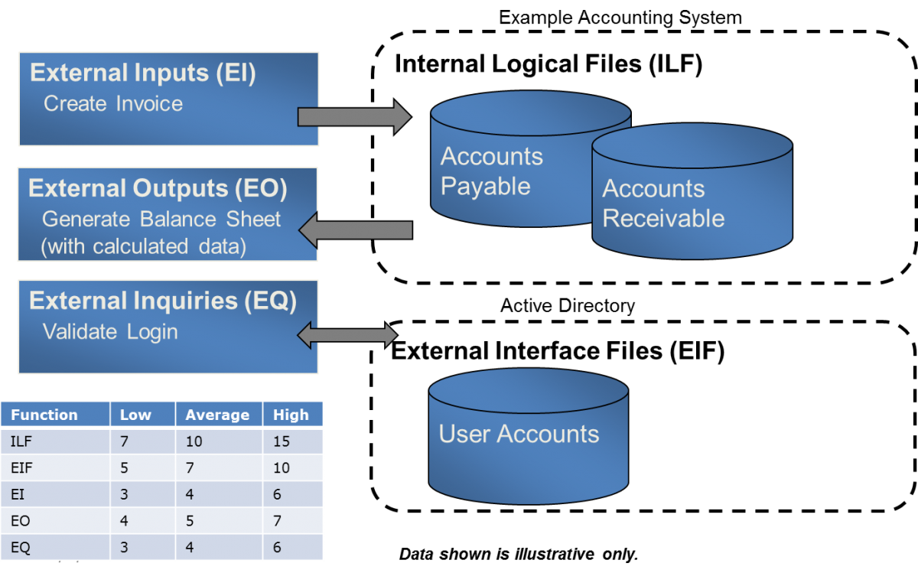
Example

Slide 9
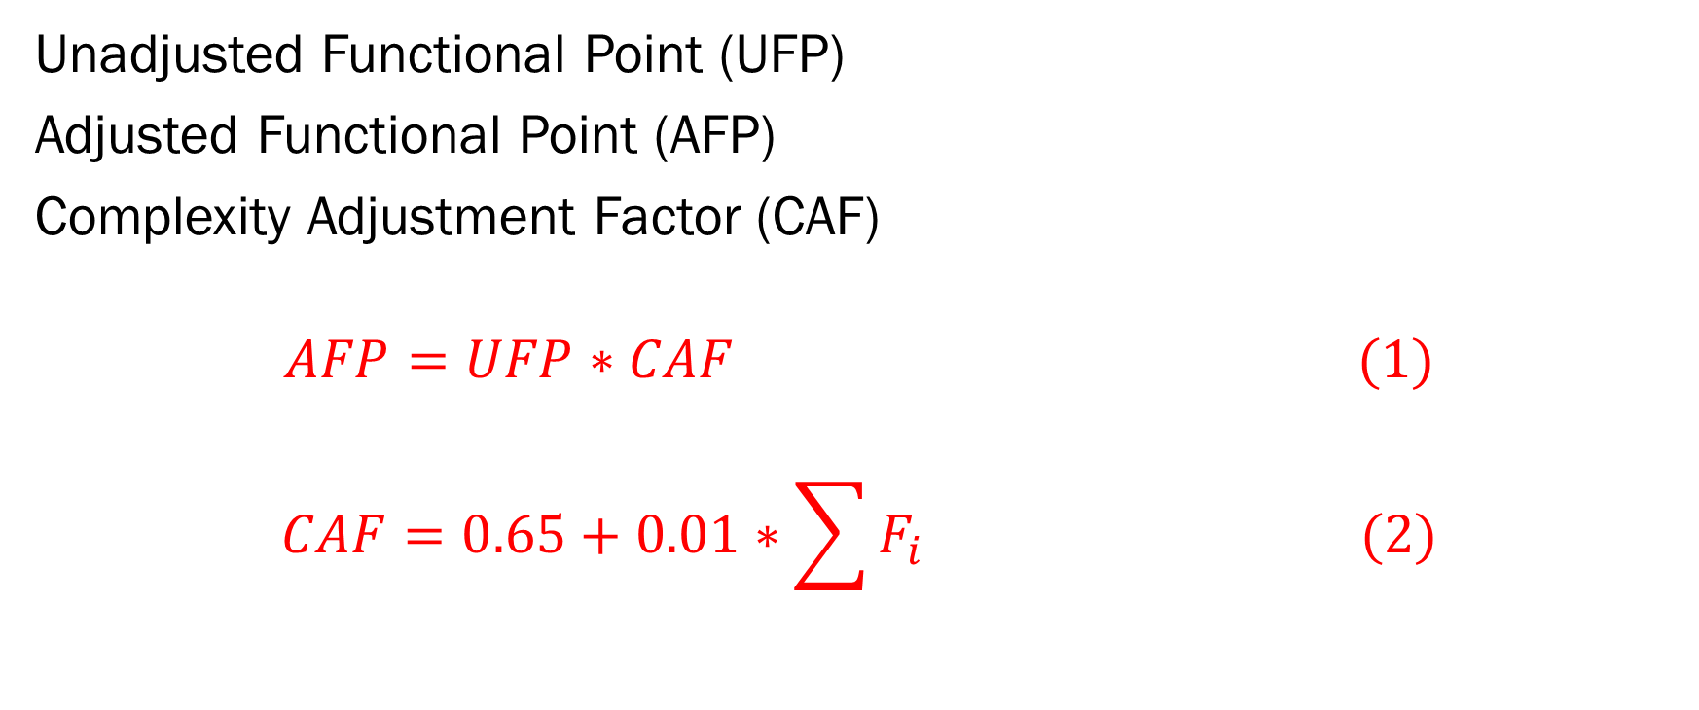
How to calculate FPA of a product?
Unadjusted Functional Point (UFP)
Adjusted Functional Point (AFP)
Complexity Adjustment Factor (CAF)
$$AFP=UFP∗CAF (1)$$
$$CAF=0.65+0.01∗\sum{F_{i} (2)}$$

Slide 10
UFP tables
How the weight is calculated?
It is totally dependent on a company how they are counting their product complexity
and updated the functional point tables time to time over development period.
For each function identified above the function is further classified as simple, average or complex and a weight is
given to each. The sum of the weights quantifies the size of information processing and is referred to as the
Unadjusted Function points.
Function unit | Weight
 | LOW | AVERAGE | HIGH
EI | 3 | 4 | 6
EO | 4 | 5 | 7
EQ | 3 | 4 | 6
ILF | 7 | 10 | 15
EIF | 5 | 7 | 10

Slide 11
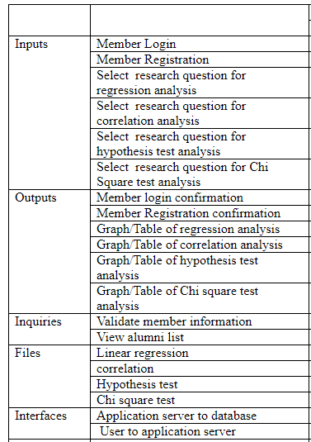
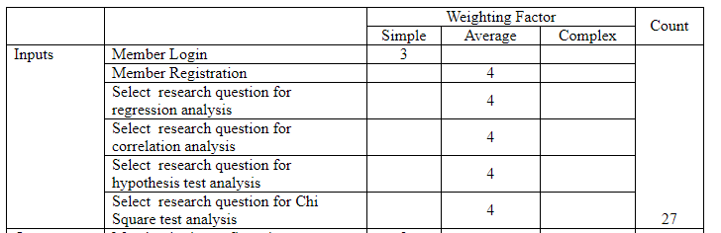
Then find each component’s complexity weight and sum it to find sub total of a single unit.

Slide 12
Example of calculating UFP
Suppose current developing software identifies the following UFP complexity for development, Then What will be the total UFP?
EI = 10 (Low complexity)
EO=13 (High complexity)
EQ = 4 (Average complexity)
EQ = 2(High complexity)
ILF = 2 (Average complexity)
EIF = 9 (low complexity)
Function unit | Weight
 | LOW | AVERAGE | HIGH
EI | 3 | 4 | 6
EO | 4 | 5 | 7
EQ | 3 | 4 | 6
ILF | 7 | 10 | 15
EIF | 5 | 7 | 10

Slide 13
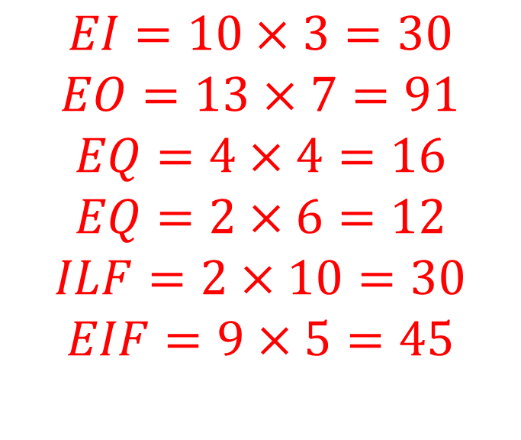
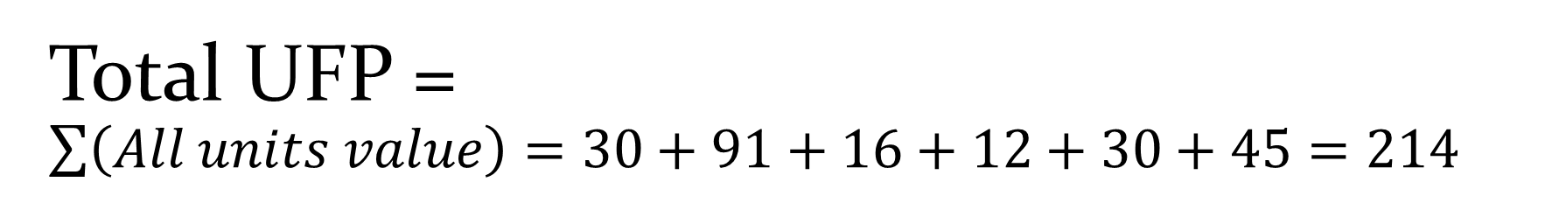
Total UFP = $\sum{\left(All units value\right)=30+91+16+12+30+45=214}$
$$EI=10×3=30$$
$$EO=13×7=91$$
$$EQ=4×4=16$$
$$EQ=2×6=12$$
$$ILF=2×10=30$$
$$EIF=9×5=45$$
Function unit | Weight
 | LOW | AVERAGE | HIGH
EI | 3 | 4 | 6
EO | 4 | 5 | 7
EQ | 3 | 4 | 6
ILF | 7 | 10 | 15
EIF | 5 | 7 | 10

Slide 14

Calculating total Complexity Adjustment Factor (CAF)
According to the eq. 2 in slide no. 9
Where, Factors are obtained from General System Characteristics (GSCs).
$$CAF=0.65+0.01∗\sum{F_{i} (2)}$$

Slide 15
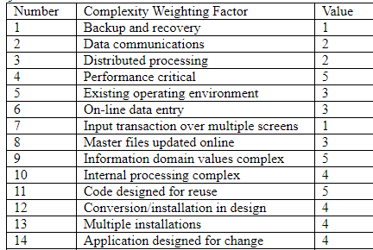
GCS
Total complexity adjustment value is counted based on responses to questions called complexity weighting factors in the table below. Each complexity weighting factor is assigned a value (complexity adjustment value) that ranges between 0 (not important) to 5 (absolutely essential).
In another word, we can say it as degree of influence that are based on response to standard questions.
0-No influence
1- Incidental
2- Moderate
3-Average
4-Significant
5- Essential

Slide 16
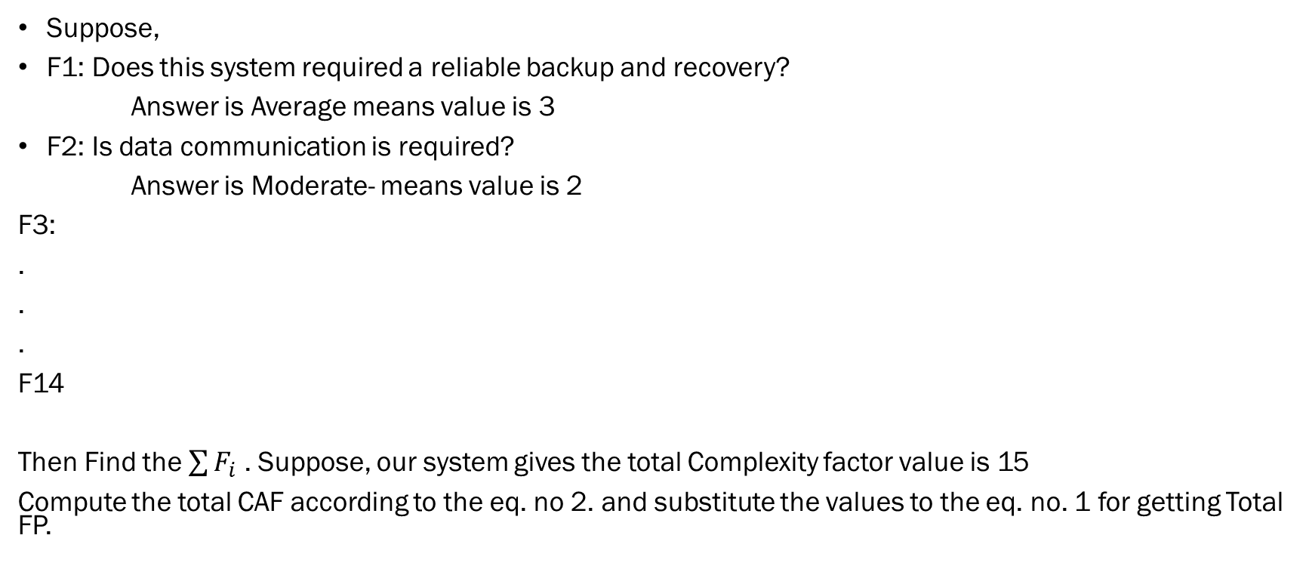
What may be the standard questions for finding factor value 0~5
Suppose,
F1: Does this system required a reliable backup and recovery?
Answer is Average means value is 3
F2: Is data communication is required?
Answer is Moderate- means value is 2
F3:
.
.
.
F14
Then Find the $\sum{F_{i}}$ . Suppose, our system gives the total Complexity factor value is 15
Compute the total CAF according to the eq. no 2. and substitute the values to the eq. no. 1 for getting Total FP.

Slide 17
Reading materials for theory exam
1. Software Project planning chapter 23- Summerville, edition-9
2. https://www.simplilearn.com/introduction-to-ifpug-function-point-analysis-tutorial

